Slide 1

CONCEPTS OF PROGRAMMING LANGUAGES
12th Edition
Chapter 13
Concurrency

Slide 2
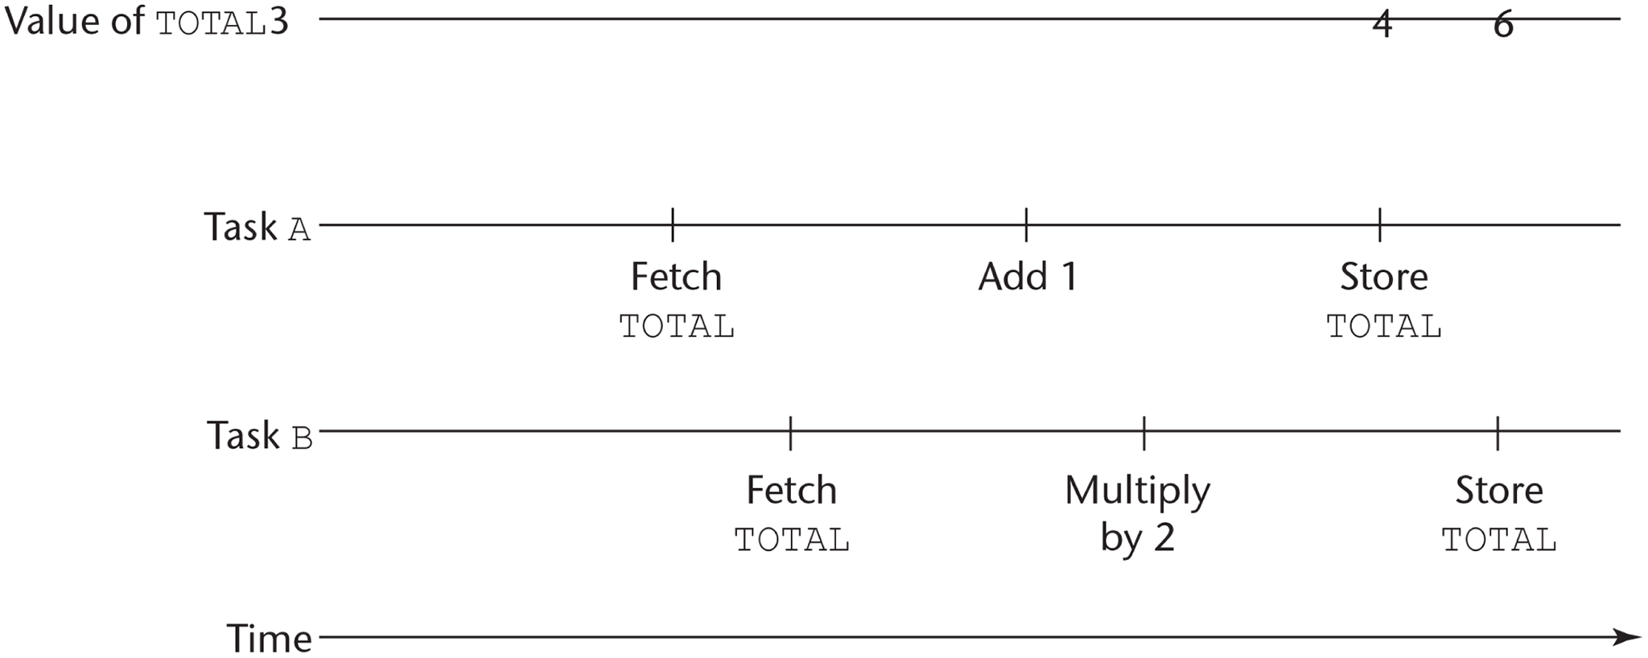
Figure 13-1 The need for competition synchronization

Slide 3
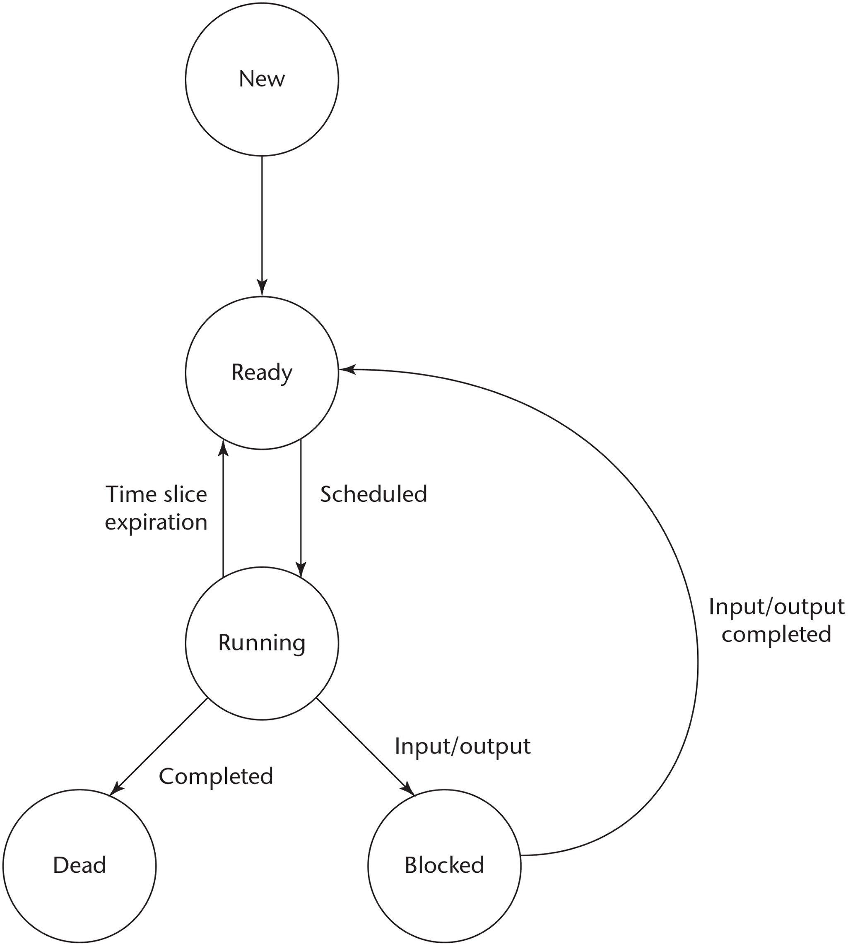
Figure 13-2 Flow diagram of task states

Slide 4
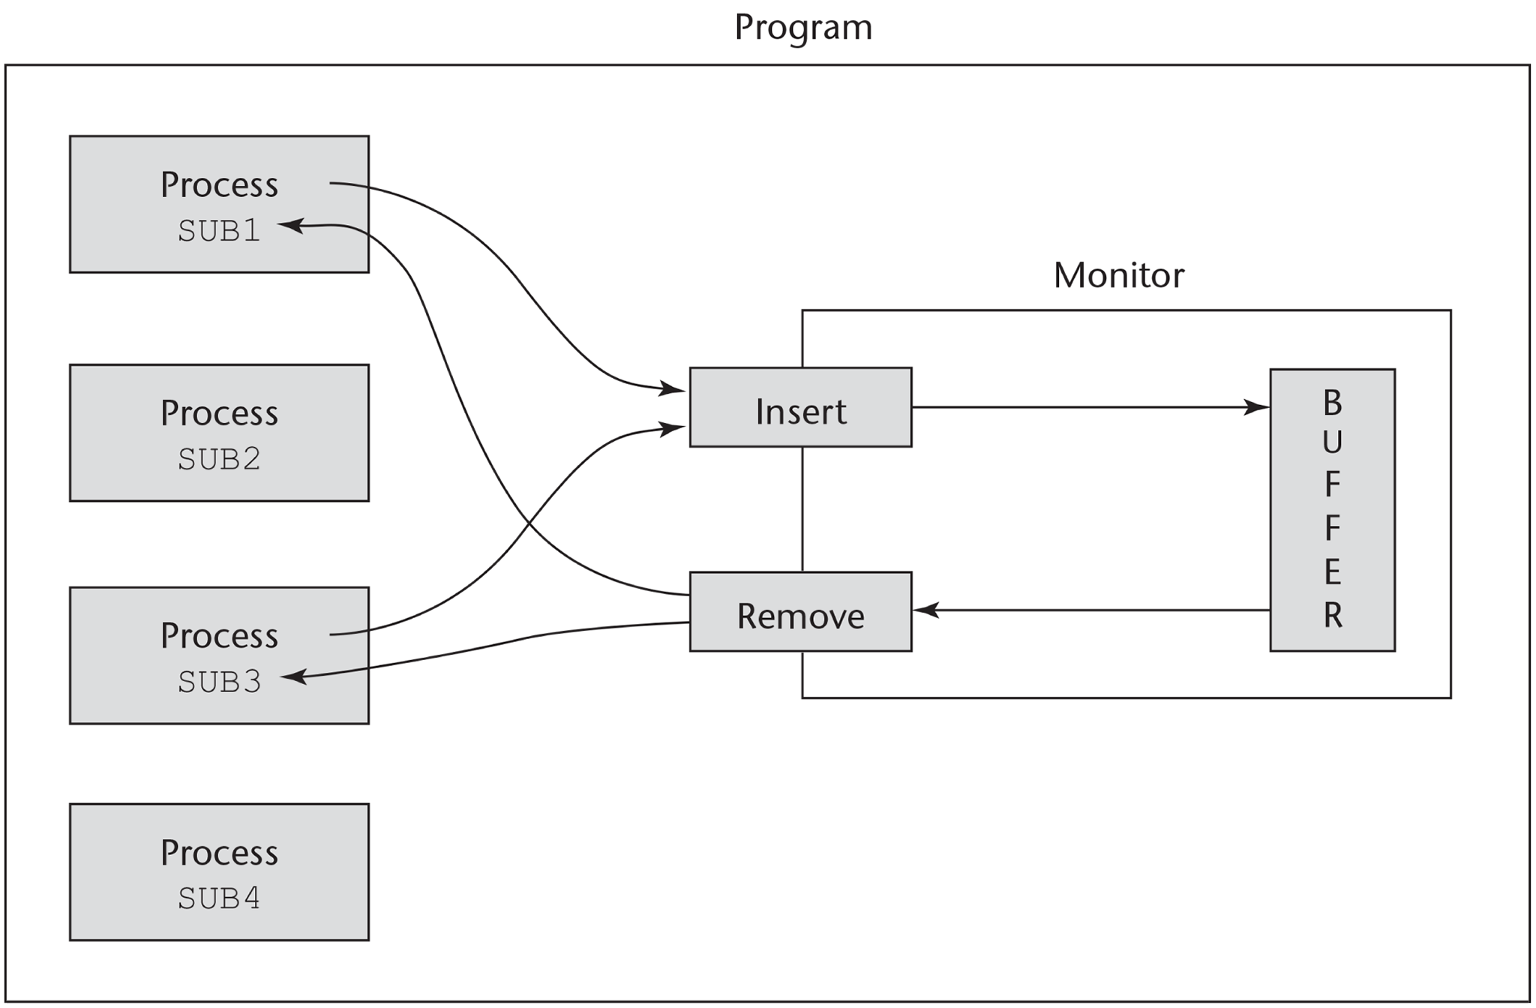
Figure 13-3 A program using a monitor to control access to a shared buffer

Slide 5
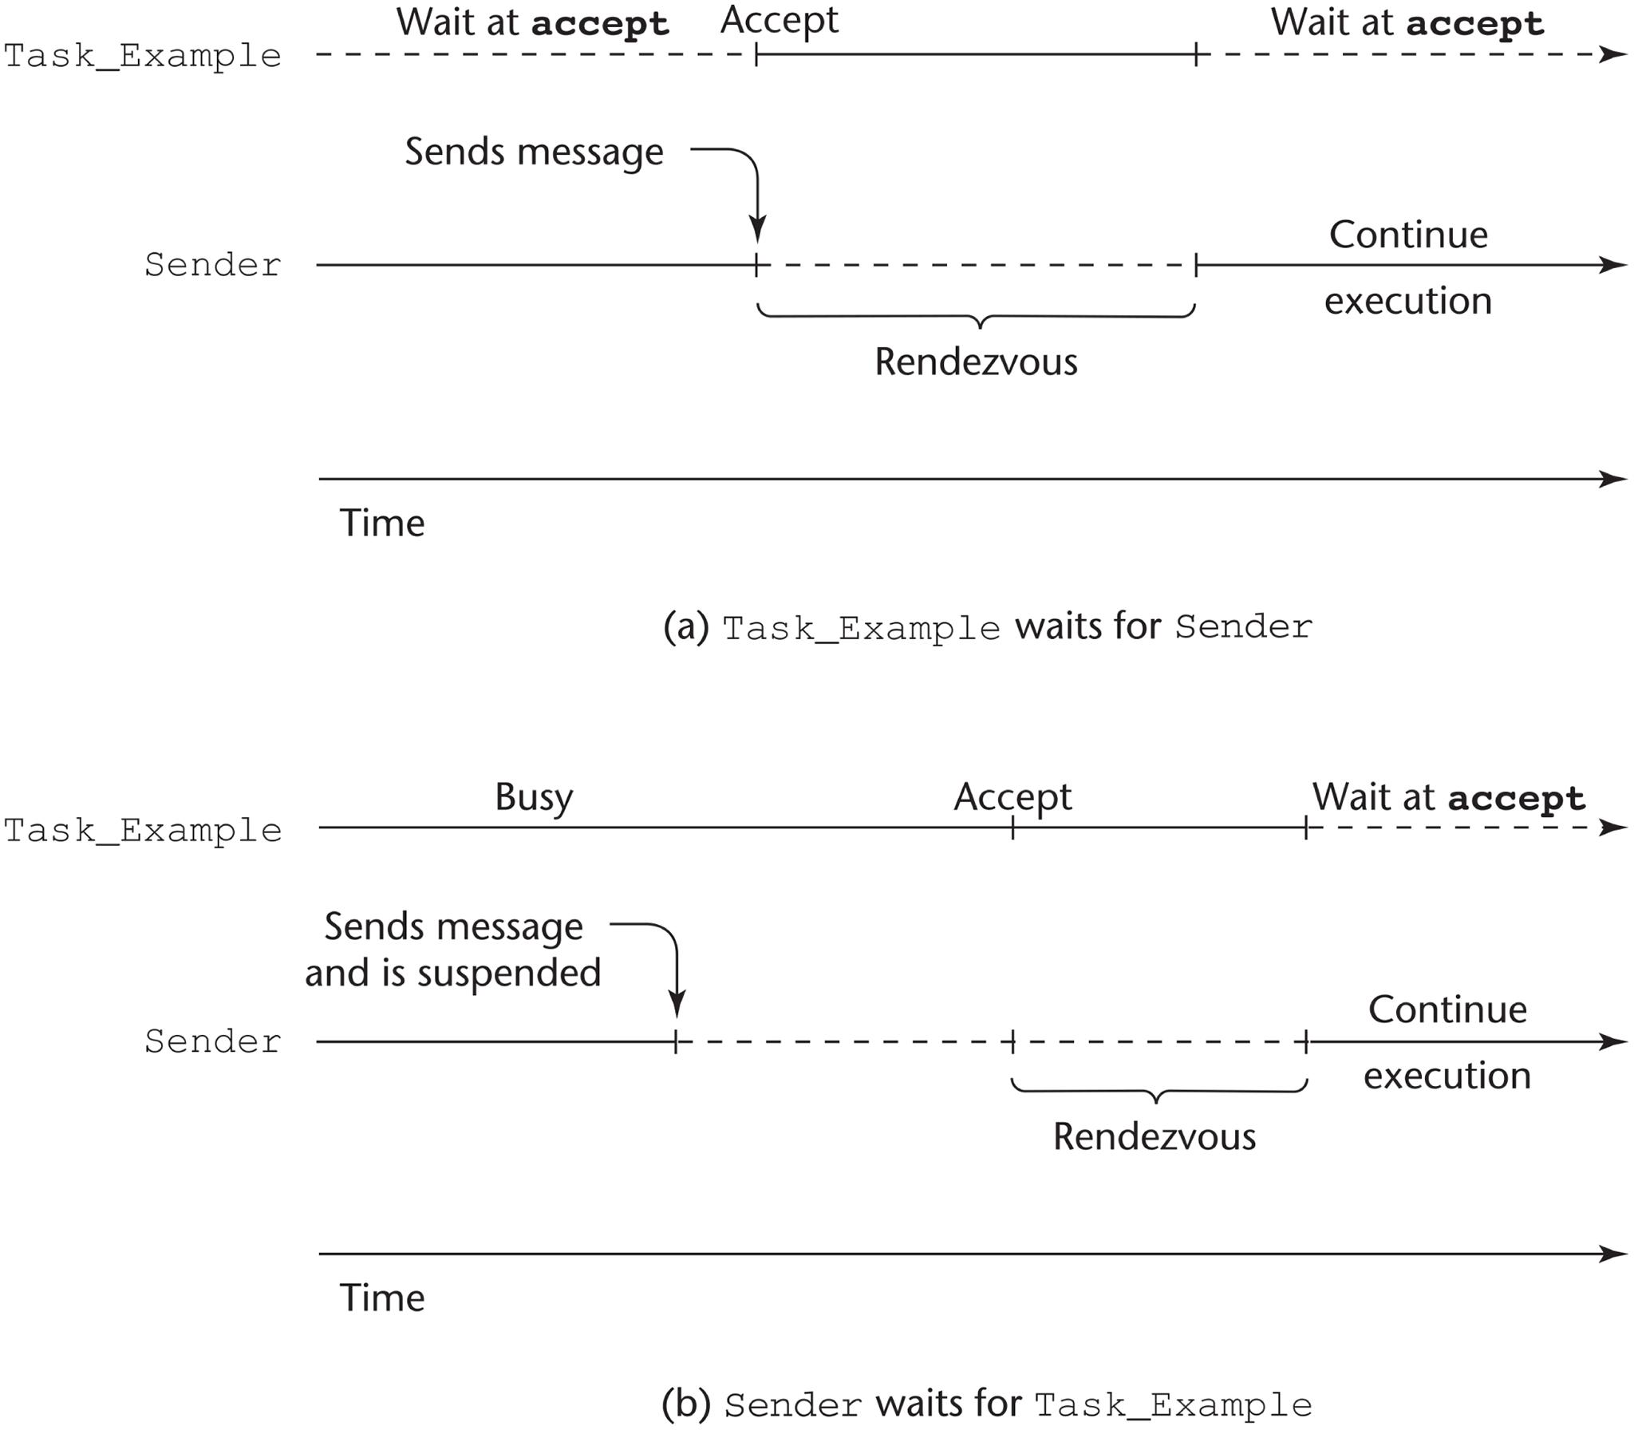
Figure 13-4 Two ways a rendezvous with Task_Example can occur

Slide 6
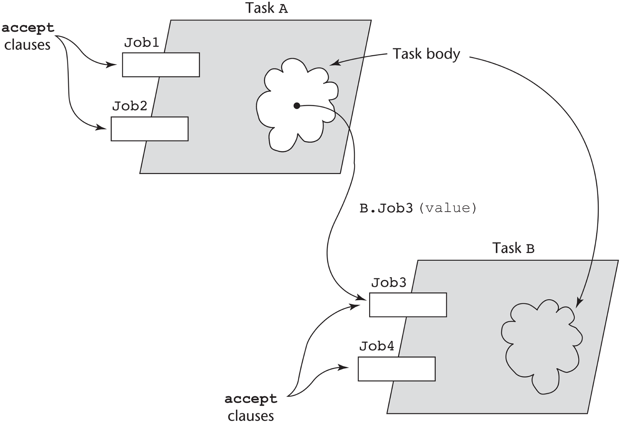
Figure 13-5 Graphical representation of a rendezvous caused by a message sent from task A to task B

